Slide 1
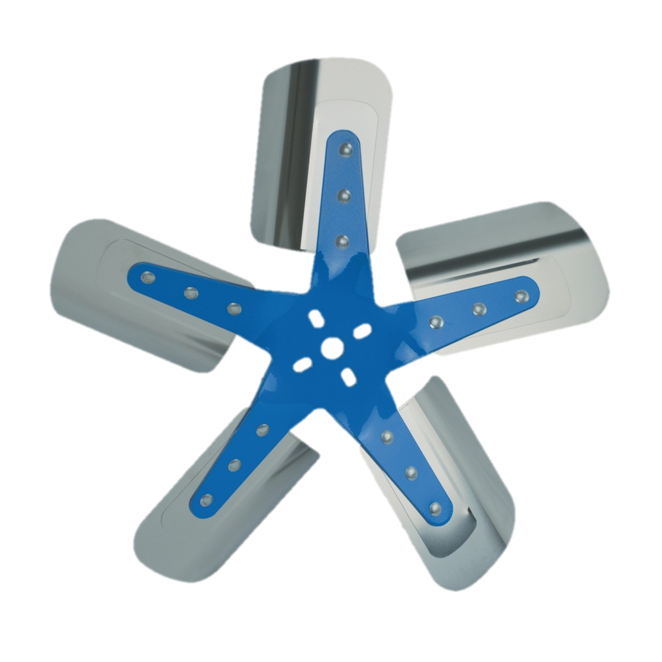
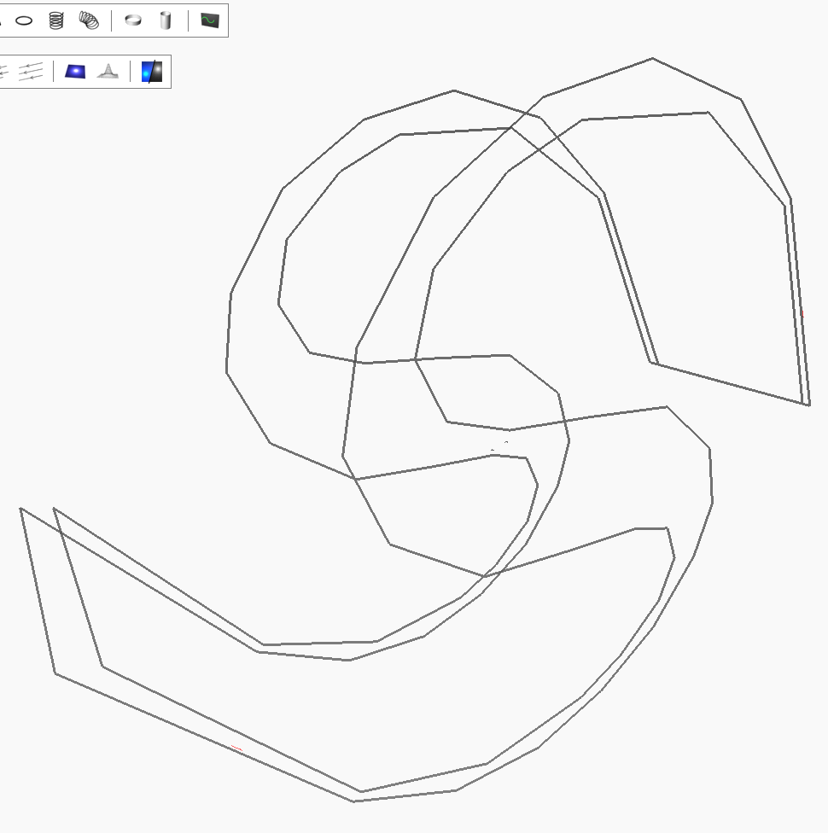
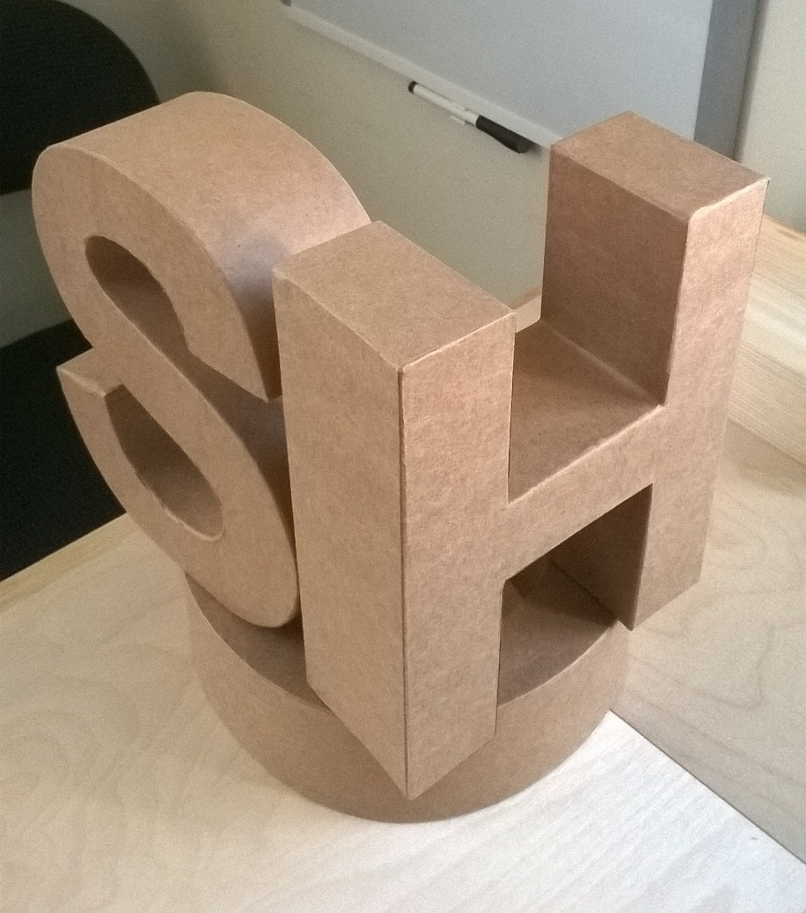
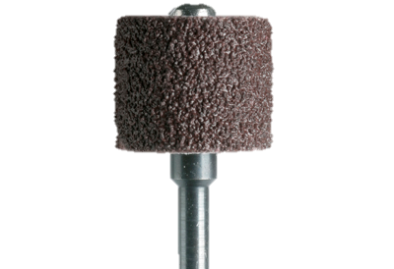
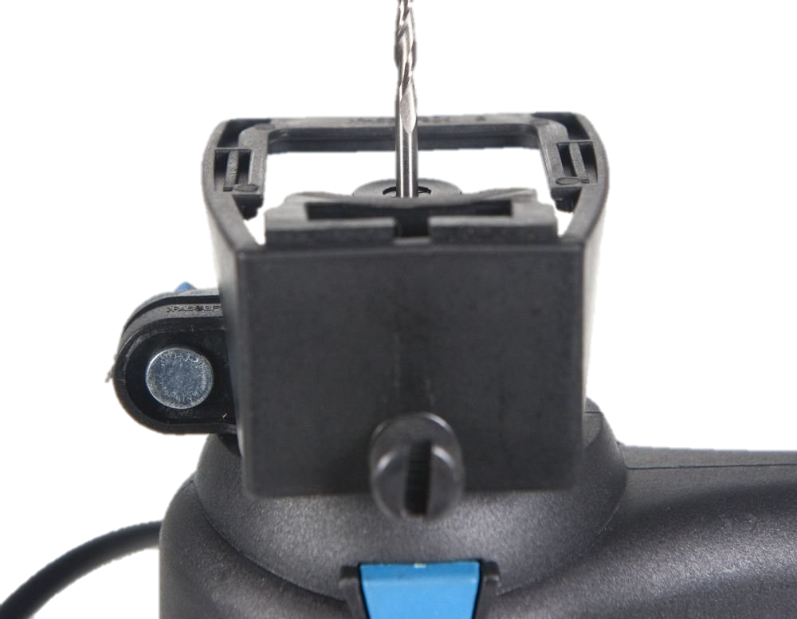
Let’s Build The S.H.O. Drive
is v
This a guide to a series of videos where I will construct the world’s first S.H.O. Drive. This will be the first drive motor in the world to have a coil that looks like an S, or an H, or an O, depending on which side you look from. S.H.O. also stands for “Side Hung Over”. What good is this for? The best way to know is to build one yourself and show it! So let’s begin!

Slide 2
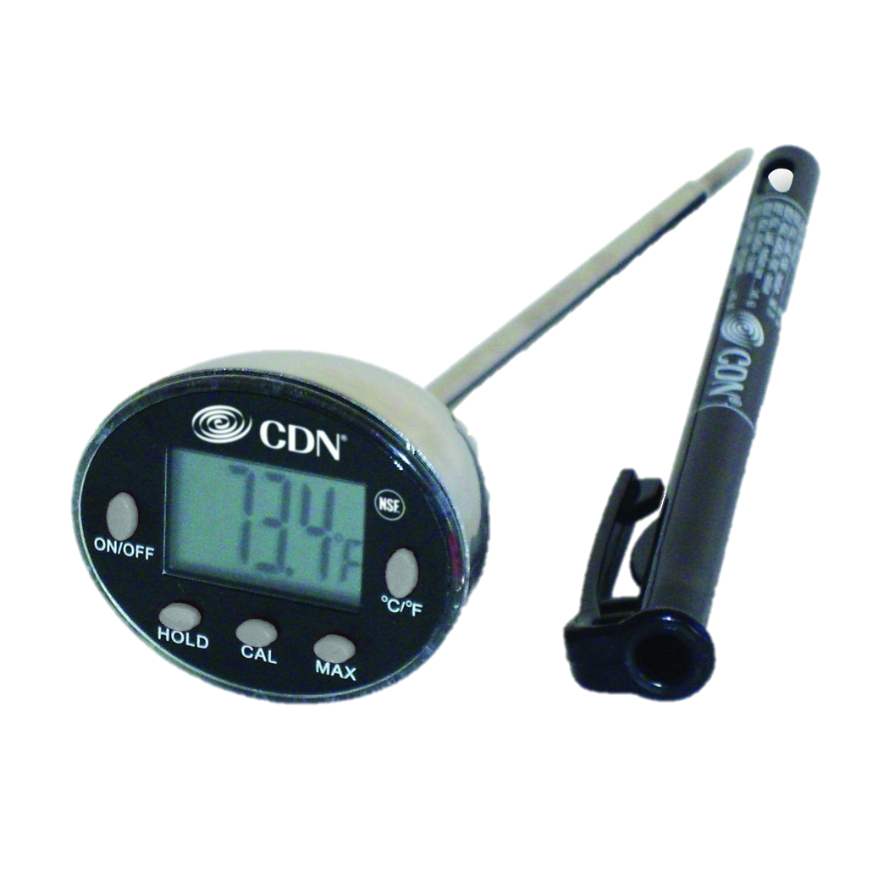
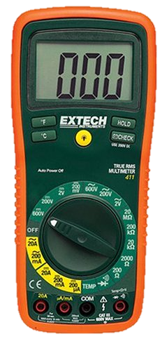
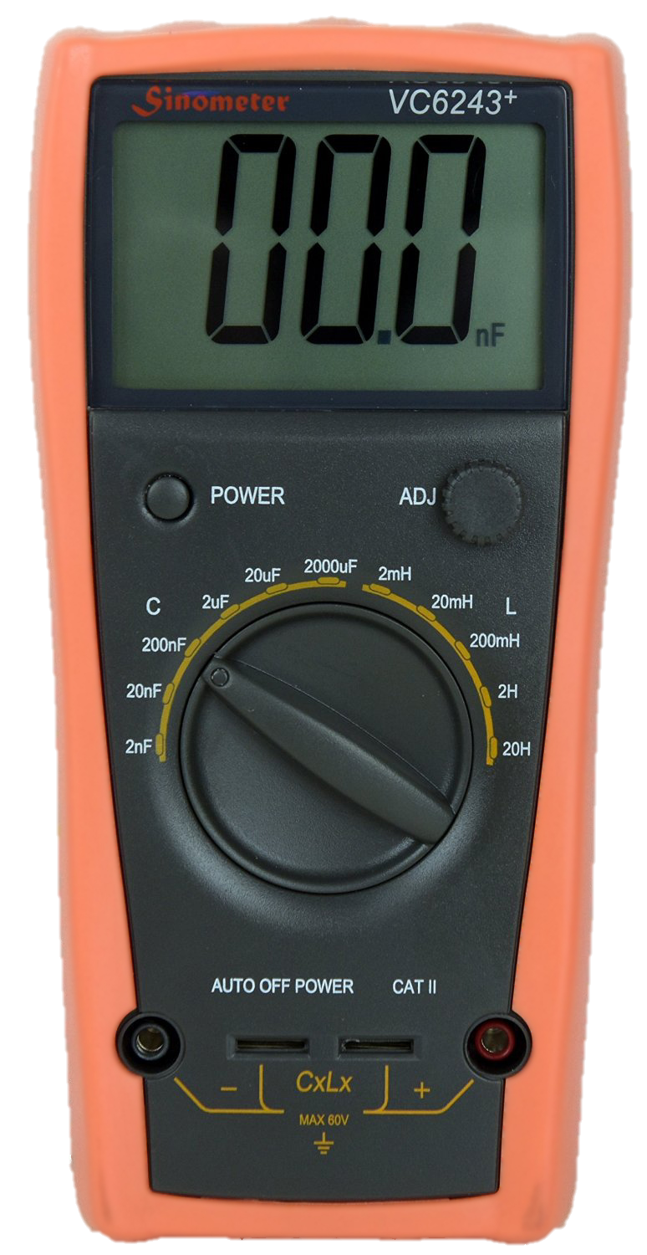
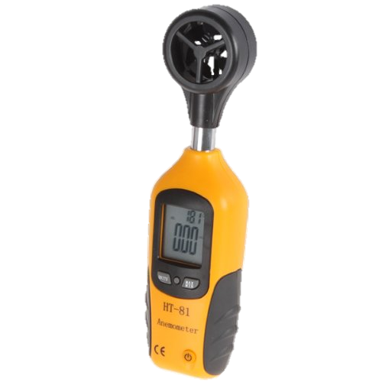
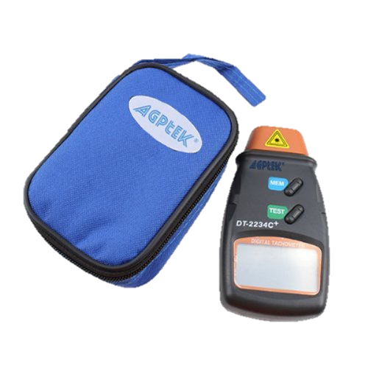
Measuring Devices (Equipment)
This project involves many measuring devices, including analog and digital thermometers, a laser tachometer, a Milli-Ohm meter, an RMS meter, a LC meter, an Anemometer, a magnetic pole detector, and a metal detector.

Slide 3
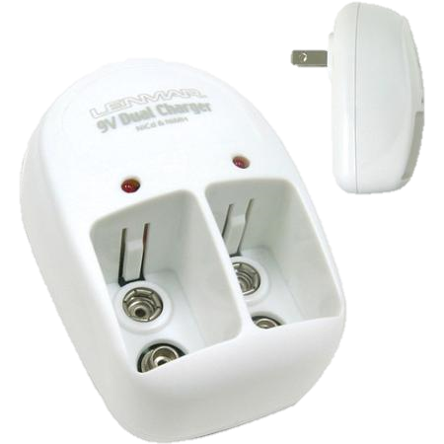
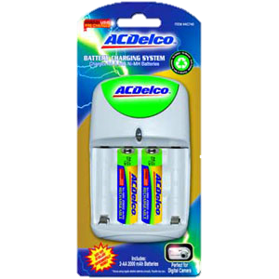
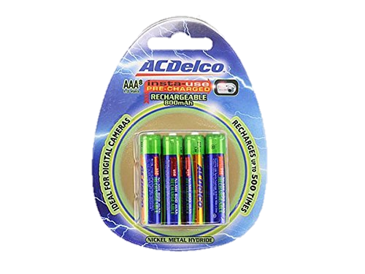
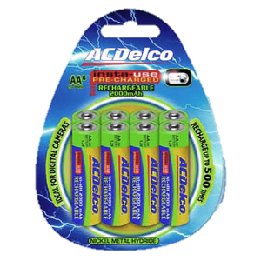
Rechargeable Batteries (Energy)
Some of these devices come with non-rechargeable batteries. When these run out, they will need to be replaced.
Where possible, rechargeable batteries will be used after the old batteries are used up.

Slide 4
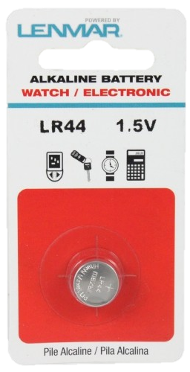
Non-Rechargeable Batteries (Energy)
Some of the measuring devices require watch-type batteries, so for these devices, non-rechargeable batteries will be used.

Slide 5
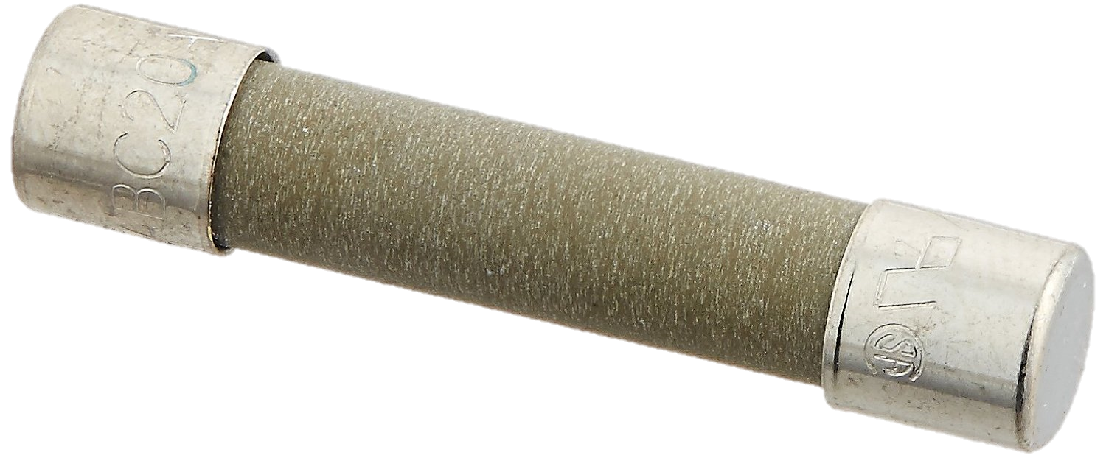
Fuses (Equipment)
Most multimeters have built-in fuses. These fuses are designed to burn out when overheated due to excessive current.
So as a matter of preparation, I have purchased compatible replacement fuses.

Slide 6
20 Amp Fuses (Equipment)
For 20 Amp protection, I purchased a 2-pack of Bussmann BP/ABC-20 20 Amp Fast Blow Fuses from Bussmann via Amazon.com

Slide 7
200 Milliamp Fuses (Equipment)
For 200 mA protection, I purchased a 5-pack of Bussmann GMA 200mA Fast-Blow Fuses from Divine Lighting via Amazon.com

Slide 8
Fire Extinguisher (Equipment)
In a worst-case scenario, the project may catch on fire due to overheating.
To reduce the losses associated with such a fire, I must have a fire extinguisher at hand.

Slide 9
Fire Extinguisher (Equipment)
So for basic safety requirements, I purchased the Amerex B500, 5lb ABC Dry Chemical Class A B C Fire Extinguisher from Amerex via Amazon.com

Slide 10
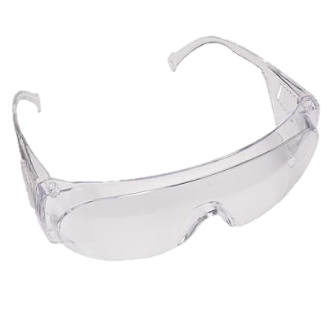
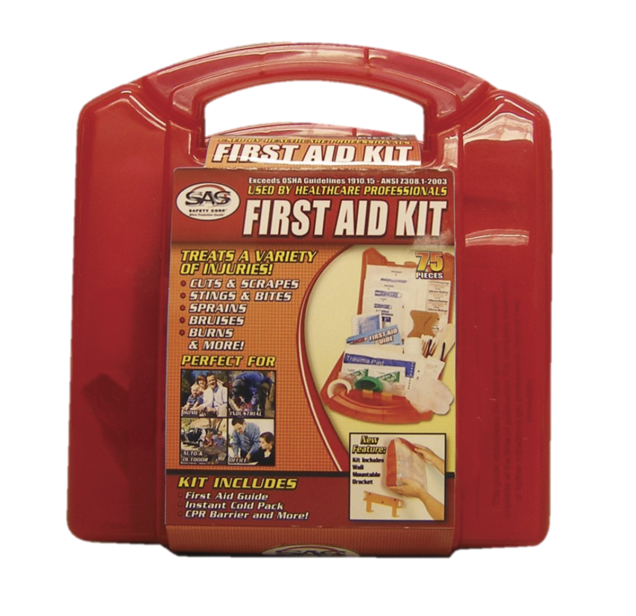
Safety Gear (Equipment)
For safety, I purchased SAS safety goggles, an SAS First Aid Kit, and FastCap Skins Gloves, which I found in extra large.
I purchased these and more at a wood-working specialty store called Woodcraft.

Slide 11
Safety Gear (Equipment)
Since my wood-working operations will be limited to sanding and drilling small holes and grooves, I will use a Western Safety Dust and Particle Mask so as to not inhale any saw dust.
I purchased this from a Harbor Freight Tools store.

Slide 12
Visual Evidence (Protocols)
After the S.H.O. Drive is built, tests will follow.
The plan is to run extended duration tests, some which will run for hours, and others for days.
An appropriate video recording device is required to provide a visual record for these tests as they happen.

Slide 13
Camcorder (Recording)
To provide evidence for these tests, I have purchased a Canon VIXIA HF R60 Camcorder from Canon via Amazon.com

Slide 14
Camcorder (Recording)
This camcorder can record up to 12 hours at normal recording speed and also has a time-lapse function to record video over several days, or more.
It can capture video at 60 progressive frames per second.

Slide 15
Memory Card (Recording)
In order to record and save very long videos, I purchased the Transcend 128GB SDXC Class 10 UHS-1 Flash Memory Card from Transcend via Amazon.com

Slide 16
Adjustable Clamp Mount (Recording)
To record video at the desired angle, I have purchased the 13.4" Smatree Adjustable Jaws Flex Clamp Mount from Smatree via Amazon.com

Slide 17
Wide Angle Lens Kit (Recording)
In order to capture a wider angle of view in the video, I purchased a Wide Angle Lens Kit from ButterflyPhoto via Amazon.com
The included .43x Wide Angle Lens provides a better approximation of human vision.

Slide 18
In Phase 1…
First on the list is to create holes which will hold bearings for the S.H.O. Drive.
Second is to install brass hinges which will connect the wood panels to the wood base.
And third is to install square nuts onto the shaft.

Slide 19
2 Barn Birdhouse Kits (Phase 1 Parts)
The wood panels I will be using will come from 2 SawDust Bros. Birdhouse Kits which I obtained from Woodcraft.
Why birdhouse kits? Well each birdhouse kit is packed with many pieces of wood of various sizes, which I may use in the future.

Slide 20
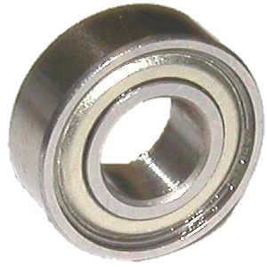
Saving Time (Protocols)
But the main reason why I purchased two Birdhouse kits was for the two front panels, which have holes that are nearly the right size for the project.
I will use the front panels from each kit as support structures to carry the weight of the bearings, rotor, and conductive copper coils.

Slide 21
Hole Size (Compatibility)
Each front panel already has a conveniently placed 1½” (or about 38 mm) hole which I will expand by 1/8” (or about 3 mm) to hold the bearings.
The bearings will be introduced in Phase 2.
Each front panel has a base side measurement of 6” (or about 150 mm). Also, they have a thickness of ½” (or about 13 mm).

Slide 22
Circle Template (Phase 1 Tools)
To mark the dimensions for the 1 ⁵/₈ ” (or about 41 mm) bearing holes, I bought a 42 circle template sheet by Timely from a specialty store called Artist & Craftsman Supply.

Slide 23
Power Drill (Phase 1 Tools)
To expand the holes for the bearings, I purchased an inexpensive rotary tool from Ferm via Amazon.com.

Slide 24
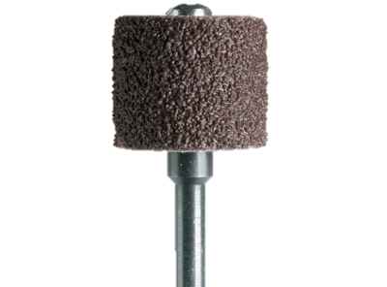
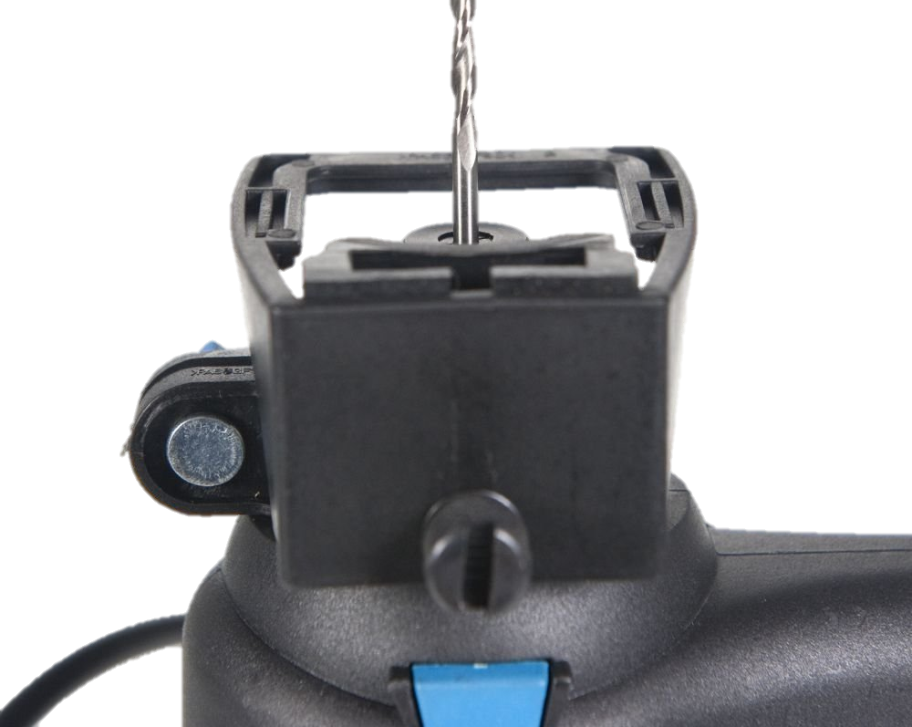
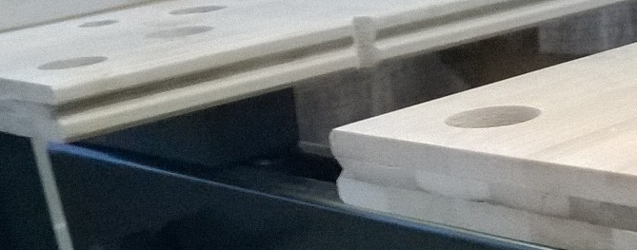
Portable Work Bench (Equipment)
I purchased from Black & Decker the WM125 Workmate through Amazon.com, which is foldable and has an adjustable width.
The clamping wood pieces have a groove which, fortuitously, can hold the depth guide of the power drill. So this work bench will effectively function as an inexpensive “router table”.

Slide 25
Dremel Accessory Set (Phase 1 Tools)
In order to finish the holes nicely to size, I will attach items from the Dremel 687-01 General Purpose Accessory Set I purchased at Fry’s Electronics.

Slide 26
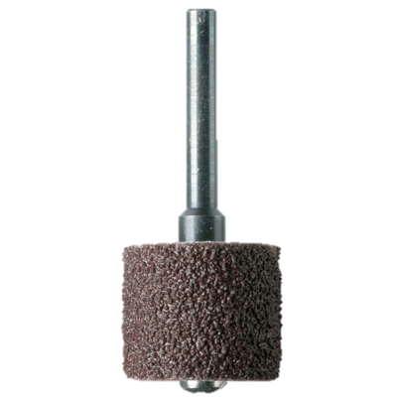
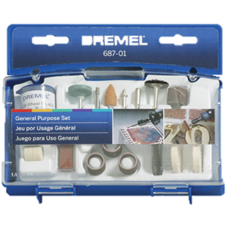
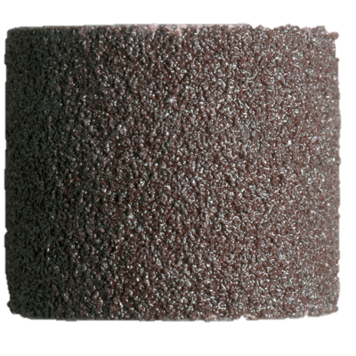
Sanding Bands & Drum (Phase 1 Tools)
The Dremel tools from the kit that I will use are the 432 Sanding Bands and the 407 Sanding Drum.
The sanding area will be ½” (or about 13 mm) thick, which will be perfect for sanding into the ½” (or about 13 mm) thick wood panels which will hold the bearings.

Slide 27
Plywood Surface (Equipment)
To make better use of the workbench for the rest of the project, I will cover the top with two pieces of Baltic Birch plywood from Woodcraft:
The side lengths are 12” (or about 30 cm)
The thickness of each is 1/2” (or about 13 mm)

Slide 28
C-Clamps (Equipment)
To hold the plywood to the workbench, I will use 3 in. Industrial C-Clamps that I obtained from a Harbor Freight Tools store.

Slide 29
Ash Wood Blocks (Phase 1 Parts)
I also have two separate Ash wood blocks, also from Woodcraft that are about 2 inches by 2 inches thick. That’s about 50 millimeters on each side. Their length is about 8 inches long, or about 200 millimeters. These blocks will serve as the “feet” of the S.H.O. Drive.
If you’re wondering what Ash wood is used for, it’s a wood often used in baseball bats.

Slide 30
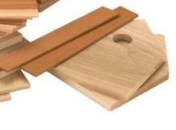
Brass Hinges (Phase 1 Parts)
So how should I attach these panels to the base blocks? Well I could simply glue and nail these panels to the base like a normal person. But here I will do something different.
From Woodcraft, I purchased these brass hinges, which I will use to attach the panels onto the ash wood blocks.

Slide 31
Transparency (Protocols)
I am a bit extra-concerned about the craftsmanship of this effort, and it would obviously be simpler to glue and nail the pieces together. But I place more value in reducing the possible ways that are available to “trick” this device.

Slide 32
Transparency (Protocols)
Furthermore, the device, when completed will be left uncovered and exposed to the surrounding elements and operated in multiple environments to reduce the number ways to trick this device.

Slide 33
Transparency (Protocols)
I do want this device to be well-built enough to operate even when transporting it, to better distinguish it from rather immobile devices which, who knows, could be powered by an object hiding behind a wall or some other structure in the room.

Slide 34
Metal Spring Clamps (Equipment)
Before drilling the pilot holes for the brass screws, I will clamp the Ash wood base blocks with Bessey XM7 3-Inch Metal Spring Clamps that I purchased from Woodcraft.

Slide 35
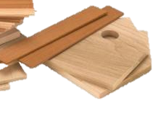
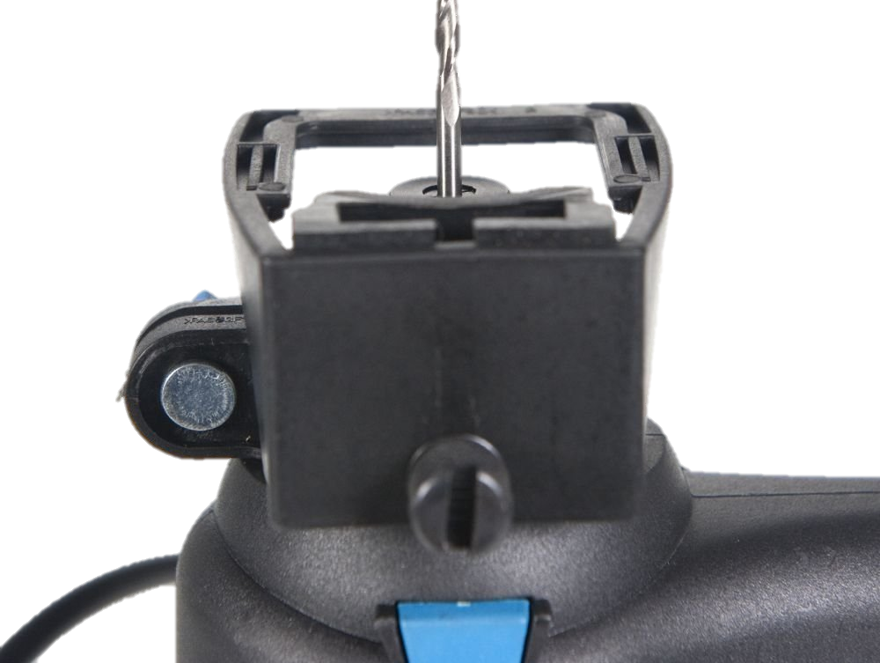
Power Drill (Recap)
Earlier in this construction Phase, I will have used a rotary tool from Ferm and the Dremel 407 Sanding Drum to make neat circular holes for the bearings.

Slide 36
Compact Power Drill (Tools)
However, to drill pilot holes for the brass screws, I will use an 18 Volt Cordless 3/8 in. Drill by Drill Master from Harbor Freight Tools. 3/8 in. is about 9.5 millimeters.

Slide 37
Drill Bits (Tools)
I also purchased a set of 3/32 in. Titanium Nitride High Speed Steel Drill Bits by Warrior from Harbor Freight Tools.
These will allow to me drill pilot holes into the Ash wood base blocks for the screws.

Slide 38
Brass Screws (Parts)
After drilling the pilot holes, I will screw the hinges tight with HighPoint Solid Brass Screws that I purchased from Woodcraft.
These are size #6 so they have a diameter of 5/16 in. (or about 8 mm) measured at the shank. The shank is the straight section next to the head of each screw.

Slide 39
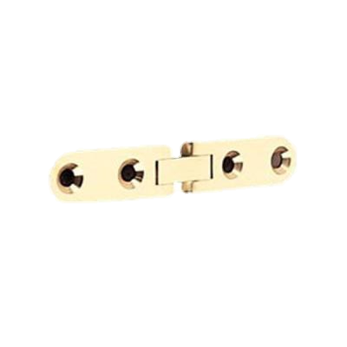
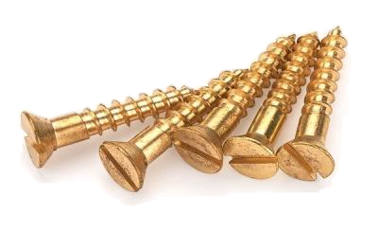
Screw Driver Set (Tools)
To tighten the screws through the brass brackets which connect the wood panels to the wood base, I purchased an iWork 53 piece Tool Set by Olympia Tools from Fry’s Electronics.

Slide 40
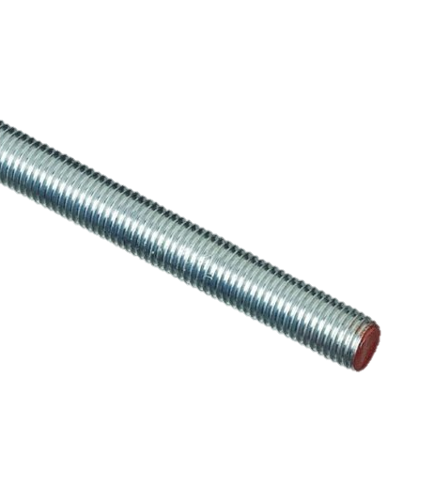
Square Nuts and Rod (Phase 1 Parts)
And finally, the simplest task in Phase 1 is to install these threaded square nuts onto a threaded steel rod.

Slide 41
Square Nuts and Rod (Phase 1 Parts)
These are zinc plated and have a fitting diameter of 5/8” (or about 16 mm) and have 11 threads per inch (11 TPI). I obtained these from Tacoma Screw.
Their diameter matches the size for the bore hole of the fan, which I will describe in further detail in Phase 4.

Slide 42
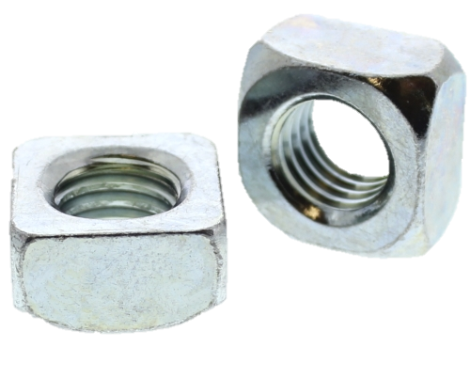
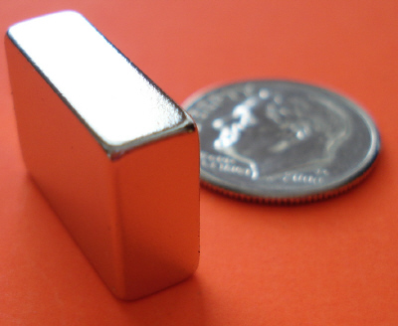
Neo Magnets (Compatibility)
These square nuts have a side length of 1” (or 25.4 mm). This is useful because the very strong Neodymium magnets that I will use for this project have imperial measurements whose thickness is ½” (or 12.7 mm). So these magnets will bond straight and level with the square nuts solely through their magnetic attraction, and no glue will be necessary on the magnets themselves.

Slide 43
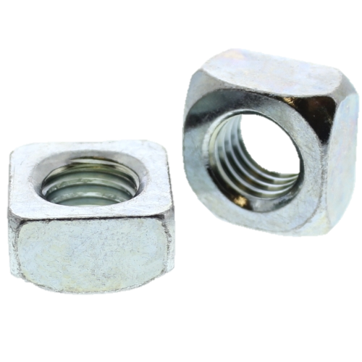
Bonding the Square Nuts (Assembly)
I will secure the position of the square nuts onto the shaft with a special-purpose glue called Loctite Threadlocker Red 271, which I purchased at Lowe’s.
This is necessary so that the torque applied to magnet will transfer to the shaft.

Slide 44
In Phase 2…
First on the list is to assemble a rotor of neodymium magnets onto the shaft.
Second on the list is to insert the rotor through the bearings securely into the disassembled wooden panels.
And third is to reattach the wood panels back onto the wood base blocks.

Slide 45
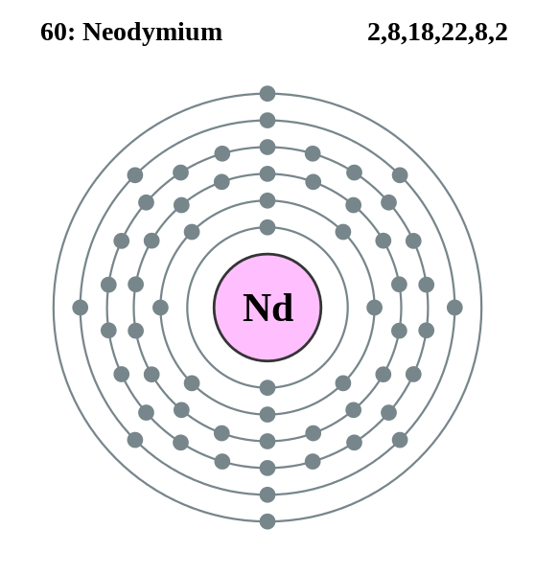
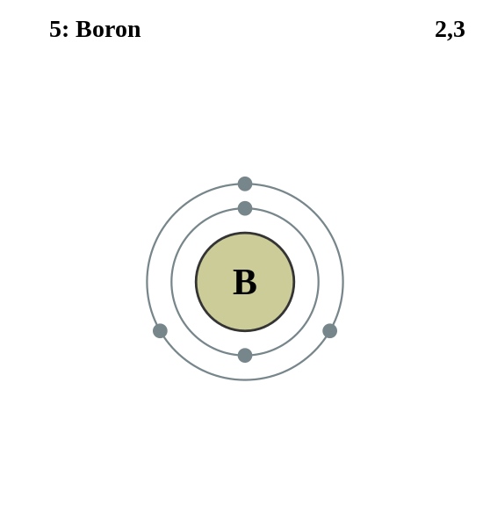
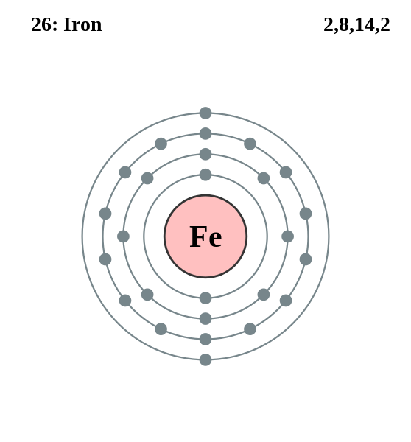
Neodymium Magnets (Phase 2 Parts)
We will need no windings on the rotor of the S.H.O. Drive. Instead the rotor of the S.H.O. Drive will be built using very strong magnets.
These magnets are an alloy of three atomic elements:
Neodymium (or Nd) (the 60th atomic element)
Boron (or B) (the 5th atomic element)
Iron (or Fe) (the 26th atomic element)

Slide 46
Neodymium Magnets (Phase 2 Parts)
These Neodymium magnets are from Magnet4less.com and are pound-for-pound some of the strongest permanent magnets that you yourself can buy on the market today.
These are often used in making wind turbine generators.

Slide 47
Neodymium Magnets (Phase 2 Parts)
Because these permanent magnets possess a stronger magnetic field, they will exert stronger magnetic forces on currents in S.H.O. coil.
In turn, the current in the wires will be able to exert stronger magnetic forces on these permanent magnets.

Slide 48
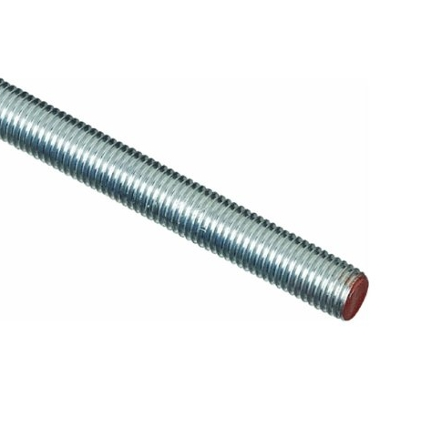
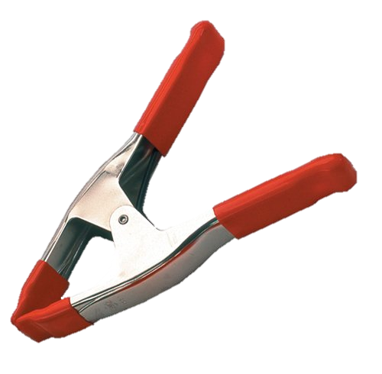
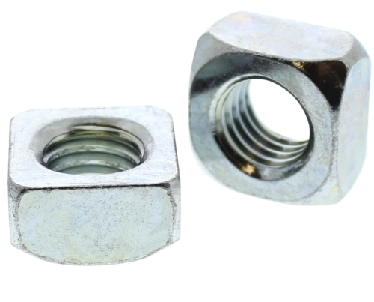
Securing the Shaft (Protocols)
To secure the shaft into place, I will thread some extra square nuts temporarily onto the shaft and clamp them down onto the Black & Decker Workmate with the Bessey XM7 3-Inch Metal Spring Clamp that I obtained from inside a Woodcraft store.

Slide 49
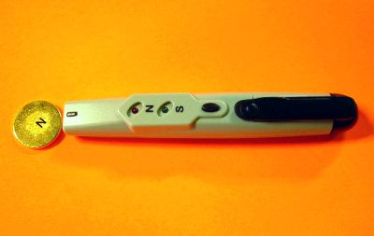
Magnetic Pole Detector (Measuring Equipment)
Before I attempt to attach the magnets to the rotor, I will identify the north pole of each magnet with a Magnetic Pole Detector that I purchased from Magnet4Less.com

Slide 50
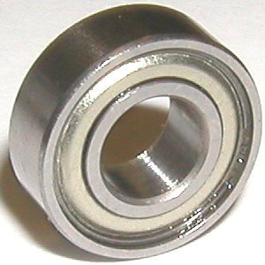
Magnetic Rotor (Assembly)
20 Large Neodymium magnets with dimensions of 3/2” x 3/4” x 1/2” (or about 38mm x 19mm x 13mm) will be stacked like Jenga blocks to form the rotor.
8 Small Neodymium magnets with dimensions of 3/4” x 1/4” x 1/2” (or about 19mm x 6mm x 13mm) will be stacked in between the large Neodymium magnets.
Together these will form a flush fit around the 3/2”x1”x1” (or about 38mm x 25mm x 25mm) square nut assembly, resulting in a magnetic rotor assembly measuring 6” (or about 150mm) long with square poles faces measuring 3/2” (or 38mm) a side.

Slide 51
Wood Panels (Disassembly)
I will unscrew the hinges off of the wood panels, enabling insertion of the shaft and bearings into the panel holes.

Slide 52
Bearings (Phase 2 Parts)
I ordered shielded ball bearings from VXB at Amazon.com. These bearings are rated as having electric motor quality and will carry the weight of the shaft.
These bearings should fit snuggly into the holes carved into the wood panels.

Slide 53
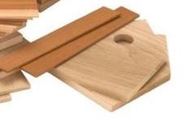
Inserting the Rotor (Assembly)
After that, I will insert the rotor assembly, through the installed bearings.
Then I will fasten the wood panels back onto to the base blocks.

Slide 54
In Phase 3…
First on the list is to make a custom rectangular spool for winding copper wire.
Second is to make the two S.H.O. coils by winding copper wire around the rectangular spool, and then carefully (and separately) bending each of these coils into the shape of an S.
And third is to install each completed S.H.O. coil onto the ceiling hooks to be installed on the wood panels.

Slide 55
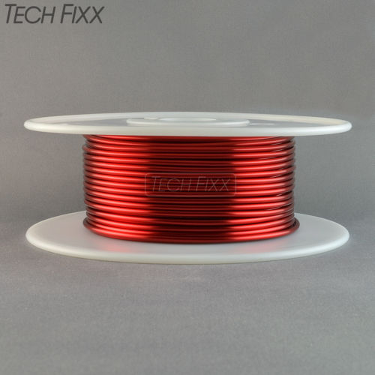
Magnet Wires (Phase 3 Parts)
The coils will be made out of a pair of copper wire spools I purchased from Tech-Fixx through Ebay.com designed for use in electromagnets.
These are known as magnet wires.

Slide 56
Magnet Wires (Phase 3 Parts)
These are size 12 gauge on the American Wire Gauge scale. Each coil has approximately 100 feet (or 30 meters) of wire, and together they will form a ½” (or 13 mm) thick bundle of copper with a combined resistance of approximately 0.3 ohms, or less than 1/3rd of an ohm.
These Essex Soderon 155 wires have a temperature rating of 311 degrees Fahrenheit or 155 degrees Centigrade.

Slide 57
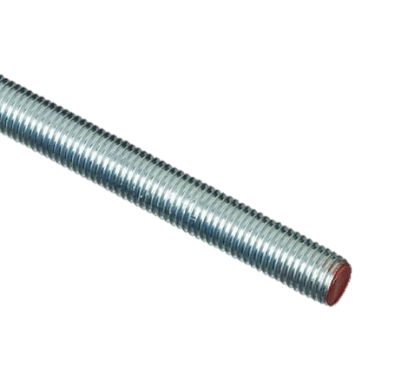
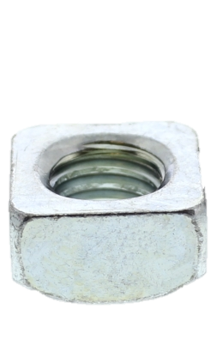
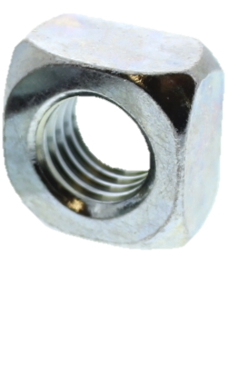
Hole Diameter (Compatibility)
The magnet wire came with spools whose hole diameter fits well with a 5/8” diameter threaded rod, which in turn can also fit holes in the Black & Decker WM125 Workmate. So I will use this to my advantage when unwinding these spools.

Slide 58
S.H.O. Drive (Design)
Unlike any other drive motor in on the market today, the S.H.O. Drive will possess a pair of rectangular conductive windings each folded in such a way to look like the letter S, the letter H, or the letter O, depending how on viewed.

Slide 59
Custom Spool (Assembly)
Each copper spool will be wound into a rectangle winding with inside dimensions of 24” by 2¼” (or 610 mm by 57 mm).
Then each winding will be carefully folded into the final form of the S.H.O. coil.
Since a spool of these dimensions will be very hard to find on the market, if it exists at all, I will have to make it custom.

Slide 60
Mailing Tube (Equipment)
The spool will be made out of a 25” (or about 635 mm) long section of a cardboard mailing tube. Pairs of notches ½” (or about 13 mm) deep will be cut into each end, and the wire will be wound through the resulting 24” by 2¼” (or about 610 mm by 57 mm) inner perimeter.
The tube originally contained square acrylic tubes I ordered from Plastic-Craft (Phase 7).

Slide 61
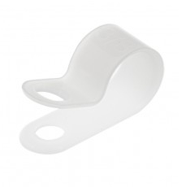
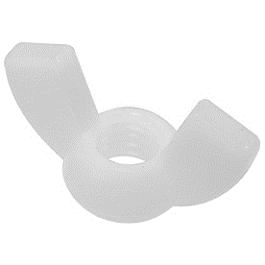
Nylon Fasteners (Phase 3 Tools)
To keep the copper winding bundle tight when curving it to the desired S-curve, several Hillman 3/8" Nylon Cable Clamps from Lowes will be fastened temporarily on the bundle using Hillman Nylon 10-24 Wingnuts and Screws also from Lowe’s.

Slide 62
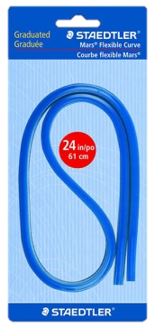
Curved Ruler (Tools)
I must ensure that the long side of the 24”x2¼” conductive winding has the correct form of S curve.
So I will be using a 24”(or 610 mm) Flexible Curved Ruler by Staedtler that I purchased from inside an Artist & Craftsman Supply store.

Slide 63
S.H.O. Coils (Assembly)
The two S.H.O. Coils will be spread apart at the middle section of the S curve to make space for the shaft in between.

Slide 64
Curved Ruler (Tools)
The 12 American Wire Gauge copper wire is significantly rigid by itself, and it will be even more so when approximately 22 turns of such wire are bundled together in each S.H.O. coil
Therefore I have used the 24” (or 610 mm) Flexible Curved Ruler by Staedtler, which is stiff in its own right, to trace various models for the S Curve of the S.H.O. Coils.

Slide 65
Visualis Electromagnetism (Software)
To digitally render the optimized shape for the S.H.O. coils, I used Microsoft Excel to overlay an XY plot chart over a scan of a desired model for the S Curve and adjusted the X and Y values to match the curve.
Then using Excel Functions, I produced the code for a *.viz file which I imported into Visualis Electromagnetism (from visualis-physics.com).

Slide 66
Tubing Bender (Phase 3 Tools)
To form the S curves of the S.H.O. Coils, I will use a 1/4”-3/8” Tubing Bender by Pittsburgh from Harbor Freight Tools.

Slide 67
Tubing Bender (Phase 3 Tools)
To hold the tubing bender to the workbench, I will use 3 in. Industrial C-Clamps that I obtained from a Harbor Freight Tools store.

Slide 68
Ceiling Hooks (Phase 3 Parts)
To hold the winding into the desired configuration, I purchased 7/8” vinyl-coated ceiling hooks from Arrow Hardware through Amazon.com.
These hooks are about the right size to hold each winding separately. They can also be turned as needed to conform to the S curves of the S.H.O. coils.

Slide 69
Wood Panels (Disassembly)
Before I can drill pilot holes onto the wood panels for the ceiling hooks, I must unscrew the hinges from the wood panels, set aside the wood base blocks, and then pull out the panels off the bearings.

Slide 70
Ceiling hooks (Assembly)
To drill pilot holes for the ceiling hooks, I will again use the 18 Volt Cordless 3/8 in. Drill by Drill Master that I purchased inside a Harbor Freight Tools store.

Slide 71
Bundle Diameter (Compatibility)
Each of the two S.H.O. Coils should have a bundled cross-section of about 3/8” inch (or 10 mm) in diameter consisting of approximately 22 turns of 12 American Wire Gauge (or 2 mm diameter) wire.
The openings in the ceiling hooks are 1/3” (or 8 mm) across. Therefore, the coils will be securely held into place by the hooks.

Slide 72
Electrical Tape (Parts)
To provide an additional electrical barrier and thermal protection between the windings and the hooks, I will be using Scotch Professional Grade 35 Red Vinyl Electrical Tape that I purchased at Lowe’s.

Slide 73
Drill Bits (Phase 3 Tools)
I have purchased a set of 7/64 in. Titanium Nitride High Speed Steel Drill Bits by Warrior from Harbor Freight Tools.
These will allow to me drill pilot holes into the wood panels for the ceiling hooks.

Slide 74
S.H.O. Coils (Assembly)
After I make the S.H.O coils and install the ceiling hooks, I will slide the wood panels back on the bearings, and then screw them back onto the base hinges.
Then I will insert the S.H.O. Coils into the ceiling hooks.

Slide 75
Wire Connector & Sandpaper (Phase 3 Parts & Tools)
In order to connect the coils together in series, I will be using Utilitech Plastic Standard Wire Connectors (Item no. 48630) and 3M 600 Grit sandpaper from Lowe’s.

Slide 76
In Phase 4…
First on the list is to show that there are no hidden batteries inside the wood pieces.
Second is to pre-drill and screw on additional wood pieces for added structural rigidity.
Third is to adhere hex nuts on the shaft in order to lock the position of the rotor.
Fourth on the list is to install ring connectors onto magnet wires where needed.

Slide 77
In Phase 4…
Fifth is to screw the ring connectors on the toggle switch and secure the switch to the base with a mounting adhesive.
Sixth is to install the fan blades on the shaft.
Seventh is to run the S.H.O. Drive and measure the resistance, inductance, as well as the operational ampere current, rotational speed, temperature, and wind speed.

Slide 78
Transparency (Protocols)
Before I finish assembly and run some tests, to show that there are no hidden batteries inside the structural wood of the S.H.O. Drive, I will remove the wood and use a metal detector to show that there is no hidden battery. Then after that is established, I will reinstall the wood pieces back on.

Slide 79
S.H.O. Coils (Disassembly)
Before I can remove the wood panels, I need to first pull out the S.H.O. Coils from the installed ceiling hooks so that I can separate the panels from each other.

Slide 80
Wood Panels (Disassembly)
After the coils are removed, I then have to detach the wood panels from the base blocks by disconnecting the screws and hinges. For this I will use pieces from the iWork 53 piece Tool Set by Olympia Tools.
The ceiling hooks can be unscrewed by hand.

Slide 81
Metal Detector (Measuring Devices)
In order to show that there are no hidden batteries inside the S.H.O. Drive wood pieces, I will use the GoerTek Portable Security Scanner that I purchased from GoerTek via Amazon.com

Slide 82
Metal Spring Clamps (Recap)
In Phase 1, in order to hold the wood pieces for pre-drilling, I used the Bessey XM7 3-Inch Metal Spring Clamps that I purchased from Woodcraft.
I will use this again to conduct further pre-drilling for some additional structural reinforcements.

Slide 83
Compact Power Drill (Recap)
In Phase 1, I pre-drilled holes for the brass screws using the 18 Volt Cordless 3/8 in. Drill by Drill Master from Harbor Freight Tools.

Slide 84
Drill Bits (Recap)
In Phase 1, for drilling pilot holes for the brass screws, I used 3/32 in. Titanium Nitride High Speed Steel Drill Bits by Warrior from Harbor Freight Tools.

Slide 85
Spacers (Phase 4 Parts)
To ensure that the bearings stay inside the holes, I will screw in HighPoint Solid Brass Screws that I purchased from Woodcraft (after pre-drilling first) to attach very small spacers over the bearing holes. The spacers came with the Birdhouse kits.

Slide 86
Wide “Wood Shingle” (Phase 4 Parts)
The length of the two ash wood base blocks differ by 1/8”, so I will pre-drill through a “wide wood shingle” onto the end of one of the base blocks, and then I will screw in additional brass screws in order to secure the wide “wood shingle” into place.

Slide 87
X-Acto Knife (Phase 4 Tools)
In order to trim off the excess wood of the wide “wood shingle”, I will use an X-Acto Knife No. 1 with Cap that I purchased from an Artist & Craftsman Supply store.

Slide 88
Narrow “Wood Shingles” (Parts)
Additional brass screws will be used to secure two narrow “wood shingles” between each end of the two base blocks to lock them at a 45 degree tilt at both sides.

Slide 89
Sho Drive
#ShoDrives
@ShoDrives
Sho.wiki Drive Replication and Collaboration Site
YouTube.com/c/ShoWiki Watch and Subscribe Site
Facebook.com/ShoDrives Like, Share, and Fan Site

Slide 90
S.H.O. Drive (Reassembly)
After the test with the metal detector and installing extra wood pieces, I will remove the “narrow shingles”, reinstall onto the wood panels the ceiling hooks, hinges, shaft, “narrow shingles”, and finally the two S.H.O. coils.
and then v

Slide 91
Hex Nuts (Parts)
I will secure the shaft with half-a-thread’s worth of special-purpose glue called Loctite Threadlocker Blue 242, which I purchased at Lowe’s.
This will hold hex nuts on the shaft adjacent to the outer facings of the bearings.

Slide 92
Terminal Rings (Phase 4 Parts)
To connect the magnet wires onto the toggle switch, I will install 10-106 Terminal Rings from Gardner Bender, which I purchased from Amazon.com.
I will crimp these onto the ends of the magnet wire and screw them onto the toggle switch terminals.

Slide 93
Sandpaper (Tools)
To maximize the connection between the terminal rings and the magnet wire, I will sand off the enamel layer at the ends of the wire using 3M 600 Grit sandpaper that I purchased from Lowe’s.

Slide 94
Crimper Tool (Phase 4 Tools)
Using the VISE-GRIP Multi Tool Stripper, Cutter and Crimper that I purchased from IRWIN Tools through Amazon.com, I will crimp the ring connector sleeves on the ends of magnet wires.

Slide 95
Toggle Switch (Phase 4 Parts)
The ring connectors will then be screwed onto a 20A toggle switch.
This is a double-pole, double-throw switch, or DPDT for short.

Slide 96
Terminal Rings (Assembly)
To tighten the screws that will hold the terminal rings onto the toggle switch. I will again use pieces from the iWork 53 piece Tool Set by Olympia Tools.

Slide 97
ON/OFF Settings (Operation)
The DPDT (or double-pole double-throw) switch, purchased from TOOGOO through Amazon.com, has one OFF setting and two ON settings.

Slide 98
OFF Setting (Operation)
When the OFF setting is selected, the S.H.O. coil will be an open circuit.
The two middle terminals or “poles” matching the OFF setting will be connected to the ends of the coil, but nothing else.

Slide 99
On Setting #1 (Operation)
When ON setting #1 is selected, it will simply close the circuit.
The two terminals or “poles” for this setting will be connected together with magnet wire.

Slide 100
On Setting #2 (Operation)
ON setting #2, when selected, may be used to connect the coil to a Sinometer VC6243+ LC meter in series with the coils.
This will be used to measure the Inductance of the S.H.O. Coil Winding.

Slide 101
LC meter (Measuring Devices)
I purchased the Sinometer VC6243+ LC meter from Sinometer via Amazon.com

Slide 102
LC meter (Measuring Devices)
The Sinometer VC6243+ LC meter can measure:
Magnetic Inductance (represented by L)
Electrical Capacitance (represented by C)

Slide 103
On Setting #2 (Operation)
ON setting #2 may also be used to connect the coil to a Vichy VC480C+ Digital Milli-ohm Meter.
This will be used to measure the Resistance of the S.H.O. Coil Winding.

Slide 104
Milli-ohm Meter (Measuring Devices)
I purchased the Vichy VC480C+ Digital Milli-ohm Meter from modders_chn via eBay.com

Slide 105
Milli-ohm Meter (Measuring Devices)
The Vichy VC480C+ Digital Milli-ohm Meter uses the 4-wire method of measuring very small resistances.
The 4-wire method involves passing a current through a resistor and measuring the voltage across the terminals.

Slide 106
On Setting #2 (Operation)
ON setting #2 may also be used to connect the coil to an Extech 411 True-RMS Multimeter.
This will be used to measure the current of the S.H.O. Coil Winding.

Slide 107
True-RMS Multimeter (Measuring Devices)
I purchased the Extech 411 True-RMS Multimeter from Fry’s Electronics.

Slide 108
True-RMS Multimeter (Measuring Devices)
The Extech 411 True-RMS Multimeter will be used calculate the root mean square or RMS of the current & voltage.

Slide 109
True-RMS Multimeter (Measuring Devices)
The heat loss in the winding can be calculated by taking the product of winding resistance and the mean square current.

Slide 110
True-RMS Multimeter (Measuring Devices)
This device does not measure the phase difference between current and voltage.
Therefore, it cannot be used to measure power in a circuit with an inductor, capacitor, or other circuit components which may cause a phase difference between current and voltage.
However, this meter can be used to calculate heat losses and measure induced voltage.

Slide 111
Mounting the Switch (Assembly)
3M Scotch Heavy Duty Mounting Tape (½” (or 13mm) wide) will be used to mount the toggle switch onto the rear “narrow shingle”.

Slide 112
Alligator Clip Leads (Equipment)
For better lead connections to On Setting #2, I purchased Heavy Duty 12 AWG - 3 Feet Long DC Power Supply Leads from PS-Mastech via Amazon.com.

Slide 113
Alligator Clip Leads (Equipment)
These leads have a wire size identical to the wire used in the S.H.O. Coil and therefore support a similar amount of current. These leads are gauge 12 on the American Wire Gauge scale.
At one end, they have banana plugs which may be connected to the multimeters which I will be using.
At the other end, these leads have alligator clips which can attach to the toggle switch at On Setting #2.

Slide 114
Output Demonstration (Protocols)
One key task is to absorb and demonstrate the mechanical output of the S.H.O. Drive.
To do this demonstration, I will use a propeller, which will transfer out mechanical energy to air, producing wind.

Slide 115
Fan Blades (Phase 4 Parts)
This Automotive cooling fan has 5 blades and has a diameter of 12” (or about 30 cm).
I purchased this item from Flex-a-Lite through Amazon.com
It’s part number 1312.

Slide 116
Washers and Hex Nuts (Parts)
I will secure the 12” (or 30 cm) diameter fan with its 5/8” (or 16 mm) bore hole, through the 5/8” (or 16 mm) diameter rod by compressing it between a pair of zinc-plated washers that I purchased at Lowe’s and a pair of zinc-plated hex nuts that I purchased at Tacoma Screw.

Slide 117
Adjustable Wrench (Phase 4 Tools)
To tighten the hex nuts against the washers and the propeller, I purchased a Kobalt 8-in (about 200 mm) Chrome Vanadium Steel Adjustable Wrench from Lowe’s.

Slide 118
Tachometer (Measuring Devices)
To measure rotation speed, I will use the AGPtek Professional Digital Laser Photo Tachometer that I purchased from AGPtek through Amazon.com

Slide 119
Tachometer (Tools)
To properly use the AGPtek Professional Digital Laser Photo Tachometer, I must use the reflective tape that was included with the kit.
This included reflective tape is designed to allow photo tachometers to accurately measure rotational speed.

Slide 120
Compact Disc (Compatibility)
I will apply the reflective tape onto the label side of a CD, which I will then insert over the 5/8” diameter threaded rod.
The diameter of the CD’s center hole is 15mm. As a result, if you take the depth of the threads into account, the CD should hold steady without modifying it.
The CD will be secured onto the shaft with hex nuts.

Slide 121
Plastic Furniture Tips (Phase 4 Parts)
To prevent the ends of the shaft from damaging things, I will cover them with 5/8” (or 16 mm) Black Plastic Furniture Tips from the Hillman Group that I purchased at Lowe’s.

Slide 122
Electrical Tape (Parts)
In order to form a tight grip between the shaft and the Plastic Furniture Tips, I will use the Scotch Professional Grade 35 Red Vinyl Electrical Tape, also from Lowe’s.

Slide 123
Electrical Resistance (Pre-run Testing)
To measure the electrical resistance of the S.H.O. Winding, I will be using the Vichy VC480C+ Digital Milli-ohm Meter.

Slide 124
Magnetic Inductance (Pre-run Testing)
To measure the magnetic inductance of the S.H.O. Winding as a function of rotor position, I will use the Sinometer VC6243+ LC meter.

Slide 125
Induced Voltage vs. Rotation (Pre-run Testing)
Using the Extech 411 RMS Multimeter and the AGPtek Professional Digital Laser Photo Tachometer, I will measure the root mean square value of the induced voltage as a function of rotation speed.

Slide 126
Electric Current (Run Testing)
During the test run, I will use the Extech 411 RMS Multimeter to measure the root mean square value of the induced current.

Slide 127
Thermometer (Tools)
To measure the temperature of the coil, I will use the DTQ450X Quick-Read Thermometer from CDN that I purchased through Amazon.com
This thermometer has a range of -40° F to +450° F (or -40° C to +230° C)

Slide 128
Thermometer Accuracy (Pre-run Testing)
I must test the thermometer to see if it takes accurate readings
First, I will test the temperature of the air near the drive motor.
Then, after sanitizing the thermometer with 70% isopropyl alcohol wipes, I will test the temperature under my tongue, which should be about 98.6 degrees Fahrenheit or 37 degrees Centigrade.

Slide 129
Before Temperature (Pre-run Testing)
After sanitizing the thermometer, I will insert the thermometer into one of the flat sections of the S.H.O. Drive Winding. I will also test the other three flat sections.
I will take out the thermometer out during the duration test, and I will set up water and ice samples to test the thermometer with, again sanitizing between measurements.

Slide 130
Duration Run (Run Testing)
I will test a duration run of the drive motor. In this test, I will measure the S.H.O. Drive’s:
Root mean square current
Wind Speed
Air Temperature
Coil Temperature
Rotational Speed

Slide 131
Anemometer (Measuring Equipment)
During the test run, I will measure the air speed in front and rear of the S.H.O. Drive fan, using the OriGlam Digital Anemometer & Thermometer from OriGlam that I purchased through Amazon.com
This anemometer can measure winds between 196 and 4900 ft/min (2.2 and 56 mph) (3.6 and 90 kph).

Slide 132
After Temperature (Post-Run Testing)
After the duration test, I will reinsert the thermometer into the S.H.O. Drive Winding into the same sections tested previously, again, sanitizing between measurements.

Slide 133
In Phase 5…
First on the list is to prepare a heavy duty basket for holding the S.H.O. Drive.
Second is to insert the S.H.O. Drive into place.
Third is to secure the meters onto the basket.
Fourth is to test and run the drive motor again as per procedure described in Phase 4.

Slide 134
Crate (Phase 5 Parts)
Now to prepare for portable testing!
I have purchased a Supreme Stacking Crate from IRIS USA through Amazon.com

Slide 135
Quality Parts (Protocols)
This crate from IRIS USA takes advantage one of the strongest engineering shapes, the triangle.
The minimal material on the sides of the crate will minimize air flow disruption.
The bottom also consists of minimal material, which allows for transparent viewing from beneath.

Slide 136
Transparency (Protocols)
This durable, light-weight crate will enable operation of the S.H.O. Drive with the fan enclosed from every side (except the top).
It helps that this crate is white, as it will maximize the ambient light inside the crate. This makes it easier to view (and record) what is inside.

Slide 137
Wooden Panels (Compatibility)
The lattice of the crate will visually complement the “house shaped” wooden panels used in the support structure.

Slide 138
Nylon Fasteners (Phase 5 Parts)
In order to prevent the S.H.O. Drive from sliding front-and-back inside the crate, I will insert pairs of Hillman 5/8" Nylon Cable Clamps from Lowes back-to-back, with their ends stuffed into small square holes at the floor of the crate.

Slide 139
Protective Edge Trim (Parts)
In order to prevent side-to-side movement of the S.H.O. Drive, I will use U Shape Car Door Edge Guard Trim from CarBeyondStore at Amazon.com at the floor of the crate.

Slide 140
Protective Edge Trim (Parts)
This protective edge trim is clear so as to be visually non-intrusive.
It will be cut into measured pieces and adhered to various sections on the crate.
It will secure the S.H.O. Drive laterally, but not vertically.

Slide 141
Angled Base Blocks (Compatibility)
Now it is time to insert the S.H.O. Drive into the crate!
By angling the base blocks by 45 degrees, the top of the fan area will be below the top of the crate.
The tilt of the base blocks will also promote ambient light scattering as well as make it harder to conceal any hidden parts.

Slide 142
Nylon Pipe Cleaners (Phase 5 Parts)
These nylon pipe cleaners go by the name Creativity Street Colossal Stems and I purchased them from an Artist & Craftsman Supply store. They are 19.5” (or about 50 cm) long.

Slide 143
Rubber Holsters (Compatibility)
Both the Sinometer VC6243+ LC meter and the Extech 411 True-RMS Multimeter have (color-matching) kickstands as well as slots on their (color-matching) protective holsters intended for holding test leads.
These features can be fastened to the crate horizontally and vertically with (color-matching) nylon pipe cleaners.

Slide 144
Multi-hour Test (Testing)
The following will be tested:
Resistance
Inductance [ f(position) ]
R.M.S. Voltage [ f(r.p.m.) ]
Rotational Speed
R.M.S. Current
Temperature [ +references ]
Refer to procedure laid out in Phase 4.

Slide 145
In Phase 6…
First on the list is to get a square tote that will be used to enclose the S.H.O. Drive inside.
Second is to secure plastic spools together and secure them in the center-bottom of the square tote.
Third is to insert protective edge trim on the handles.
Fourth is to run an enclosed extended duration test.

Slide 146
Square Tote (Phase 6 Parts)
In order to enclose the S.H.O. drive for the following test, I will use a Square Storage Box from The Container Store.

Slide 147
Plastic Spools (Phase 6 Parts)
To better secure the Supreme Stacking Crate from IRIS USA inside the Square Storage Box, I will use the two plastic winding spools (from Phase 3) so I can elevate the crate closer to the lid of the box.

Slide 148
Protective Edge Trim (Parts)
In order to secure the spools together and to center the crate against the indentions on the lid of the box, I will use U Shape Car Door Edge Guard Trim from CarBeyondStore at Amazon.com

Slide 149
Analog Thermometers (Measuring Devices)
To measure the temperature inside and outside the tote during its operation, I purchased a 12-Pack of Sper Scientific 739520 Wall Thermometers from Sper Scientific via Amazon.com

Slide 150
Temperature (Pre-run Testing)
Before I run the device, I will apply some masking tape on each thermometer and write on each the location that each will be placed during the test.
I will then place the thermometers near each other, and away from the windows, for a couple of minutes. Then I will compare their readings.

Slide 151
Temperature (Continuous Testing)
During the continuous testing, I will record their temperature periodically on camera without moving them.
To minimize data noise. I will keep the heater off and the windows and blinds closed. Preferably, clouds would be overcast during this period, or else I could choose to instead conduct the test overnight.
I will put a thermometer wherever window blinds are missing.

Slide 152
Temperature (Post-run Testing)
After the test run, these thermometers will be brought together once again away from the windows to show again for a couple of minutes to see if they give the same reading.

Slide 153
In Phase 7…
First is to prepare a stable platform to attach the S.H.O. Drive.
Second is to arrange a place outside to run an extended duration test.
Third is to the connect a portable power supply to run the camcorder outdoors for an extended period of time (several hours).
Fourth is to run an outdoor extended duration test.

Slide 154
Music Stand (Equipment)
To provide an elevated structure to secure the S.H.O. Drive, I purchased the Talent MUS-3 Heavy Duty Steel Fixed Base Music Stand from Talent at Amazon.com

Slide 155
Music Stand (Equipment)
Like many music stands, the angle of the desk can be adjusted 180 degrees.
The tilt can be adjusted to aid viewing of the S.H.O. Drive from the bottom as well as the top.

Slide 156
Music Stand (Equipment)
Unlike many music stands, the base is fixed and made of heavy gauge steel.

Slide 157
Barbell Plate (Equipment)
In order to prevent the music stand from tipping over, I will lower its center of gravity.
To do this, I will glide a barbell plate over the pole of the music stand to rest on the heavy duty base.

Slide 158
Barbell Plate (Equipment)
This barbell plate is the 45 pound (or 10 kilogram) CAP Barbell Olympic Grip Plate. I purchased it from CAP Barbell via Amazon.com

Slide 159
Transparency (Protocols)
In order to provide an unobstructed view of the S.H.O. Drive, I will clamp Acrylic Tubes onto the desk of the music stand and then slide the crate, which holds the S.H.O. Drive, through these tubes.

Slide 160
Acrylic Tubes (Equipment)
The ones I purchased are 72” (or about 180 cm) Long Acrylic Square Tubes from Plastic-Craft via Amazon.com
This includes a 5-pack consisting of tubes ¼” (or about 6 mm) across and a 2-pack of tubes ½” (or about 13 mm) across

Slide 161
Laminate Scorer (Tools)
In order to split the 72” tubes in half, I purchased the OLFA 1090486 PC-L Plastic/Laminate Scorer from Olfa via Amazon.com.

Slide 162
Tubes (Assembly)
In order to increase the rigidity of the tubes, I will apply a glue to bond the ¼” tubes alongside the ½” tubes.
Then I will clamp them to the workbench and let them cure 1 hour.
These tubes will later hold the S.H.O. Drive when it is operating.

Slide 163
Tubes (Assembly)
The glue I will use to bond the ¼” and ½” Acrylic tubes together is the Loctite Epoxy Plastic Bonder which I purchased from Lowe’s.

Slide 164
Acrylic Sheet (Equipment)
There will be four acrylic tube-pairs to secure.
I will use the Loctite Epoxy Plastic Bonder to adhere these tubes to a Cast Acrylic Sheet from Small Parts via Amazon.com.

Slide 165
C-Clamps (Equipment)
The tubes will slide tightly through the crate, securing the S.H.O. Drive into the crate, no matter the tilting angle.
To secure the attached acrylic plate to the music stand, I will use a pair of 3 in. Industrial C-Clamps that I obtained from a Harbor Freight Tools store.

Slide 166
Let’s Test the S.H.O. Drive Outside!
Just after I moved in to my studio apartment on September 2015, this orange “tag” appeared nearby, visible from my unit, in an area I pass by regularly. On July 26, 2015, I renamed the “S-Motor”, as it was called originally, to “S.H.O. Motor”.

Slide 167
PREFERRED TEST LOCATION Gas Works Park 2101 N Northlake Way, Seattle, WA 98103
The actual test location is yet to be determined. (April 18, 2016)

Slide 168
Continuous Recording Outdoors (Protocols)
In order to record an outdoor test of extended duration, the camcorder (a sensitive electronic instrument) must be continually charged by an external supply of energy.
8+ Hr
recording

Slide 169
AC-to-DC Adapter (Equipment)
To supply energy to the camcorder indefinitely when it is recording, its 3.6V battery must be charged through a special 5.3V power adapter designed for the camcorder.
The adapter must be connected to a source of alternating current of standard voltage and frequency.
Per the manual, the camcorder consumes around 3 watts when recording video, though this will depend on the camera settings.
8+ Hr
recording

Slide 170
DC-to-AC Inverter (Equipment)
In order to supply energy to the adapter in the form of alternating current, I purchased the BESTEK 300W 12V to 110V AC Inverter from BESTEK via Amazon.com
8+ Hr
recording

Slide 171
12V DC Battery Cables (Equipment)
In order to connect the inverter to a supply of 12V DC energy, I purchased a RoadPro 12V Battery Clip-On and Cigarette Lighter Adapter from RoadPro via Amazon.com
These cables can support up to 10 amps at 12 volts DC.
8+ Hr
recording

Slide 172
12V Battery (Equipment)
For the 12V energy source, I purchased an ExpertPower 12V 7 Amp EXP1270 Rechargeable Lead Acid Battery from ExpertPower via Amazon.com
8+ Hr
recording

Slide 173
12V Battery (Equipment)
This 12V battery is rated at 7 ampere-hours, based on 20 hours of steady electrical discharge.
This means it can deliver 84 watt-hours of energy (or about 300 kilojoules) over a 20 hour period (an average of 4.2 watts).
8+ Hr
recording

Slide 174
Battery Enclosure (Equipment)
In order to protect the battery and inverter from the outside elements, I purchased the NOCO HM318BKS Group 24-31 Snap-Top Battery Box from NOCO via Amazon.com
8+ Hr
recording

Slide 175
Tripod (Equipment)
To record stable video of the S.H.O. Drive from a distance, I will attach the camcorder to a 72” Tripod that I purchased from ButterflyPhoto via Amazon.com

Slide 176
Multi-hour Test (Testing)
The following will be tested:
Resistance
Inductance [ f(position) ]
R.M.S. Voltage [ f(r.p.m.) ]
Rotational Speed
R.M.S. Current
Temperature [ +references ]
Refer to procedure laid out in Phase 4.

